Slide 1
MMP-350 Class 2
Designing with data

Slide 2
Making it look good
Thesis: Appearance matters

Slide 3
branding
Range: neutral and conservative to some form of specific message: We’re cool, we’re competent, we’re stylish, we’re trustworthy

Slide 4
Content is separate from Style
http://csszengarden.com

Slide 5
Tufte on graphical displays
Graphical displays should:
Show the data
Induce the viewer to think about the substance rather than about the methodology, graphic design, the technology of graphic production
Avoid distorting what the data have to say
Present many numbers in a small space
Make large data sets coherent
Encourage the eye to compare different pieces of data
Reveal the data at several levels of detail, from a broad overview to the fine structure
Serve a reasonably clear purpose: description, exploration, tabulation, or decoration
Be closely integrated with the statistical and verbal descriptions of a data set.
Graphics reveal data
Source: Tufte, Edward The Visual Display of Quantitative Informationm Second Edition Graphics Press LLC (Chesire Connecticut: 2001) page 1

Slide 6
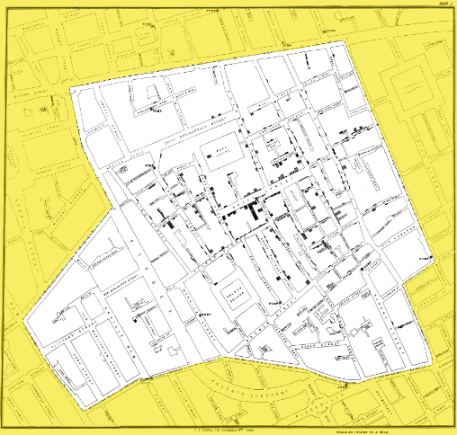
Cholera Example
Tufte’s view: visualization reveals connection not hitherto scene

Slide 7
Pete Warden’s revision
John Snow’s visualization didn’t reveal a hypothesis, it tested it.
See http://petewarden.com/2010/10/21/visualization-myths-around-snows-cholera-map/

